Slide 1
STUDENT CLUB ADVISOR TRAINING
Notes:
Sue

Slide 2
AGENDA
Introductions
Importance of Club involvement
Your role as an advisor
Learn to Live
Club Requirements
Club procedures
Staying Connected
Important Dates
Notes:
Sue

Slide 3
INTRODUCTIONS
Name
Department
Club you advise
How long you have been a club advisor

Slide 4
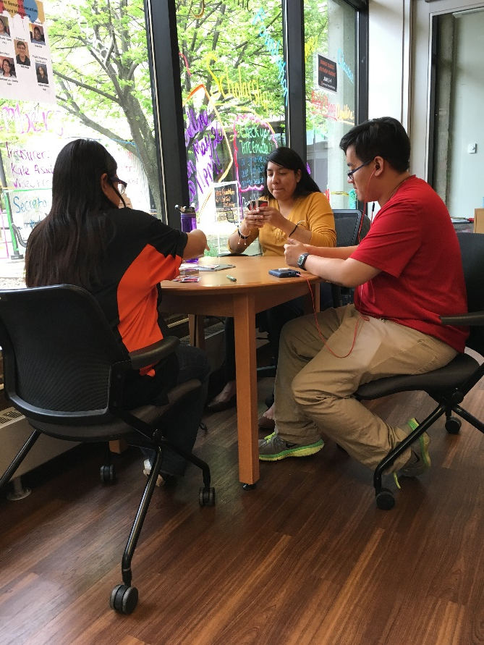
IMPORTANCE OF CLUB INVOLVEMENT
Supports student persistence and graduation rates
Creates community and gives students a sense of belonging
Offers students leadership experience

Slide 5
YOUR ROLE AS AN ADVISOR
Mentor
Help students with functions of the club
Notes:
Encourage full participation- meet regularly
Oversee selection and training of club leaders
Establish relationships with club leaders/members
Ensure events/activities conform to HTC’s policies
Oversee the club budget
Provide signature authority for paperwork
Oversee campus travel and paperwork
Ensure events/activities conform to HTC’s policies
Oversee the club budget
Provide signature authority for paperwork
Oversee campus travel and paperwork

Slide 6
YOUR ROLE AS AN ADVISOR
Mandatory Reporter
Club Advisors are also Mandatory Reporters and are required to report sexual misconduct, relationship violence, stalking, or retaliation to the College.
Reports go through Student Life and Career development to the Vice President of Student Affairs
Students of Concern https://cm.maxient.com/reportingform.php?HennepinTC&layout_id=0
Notes:
Stephen

Slide 7
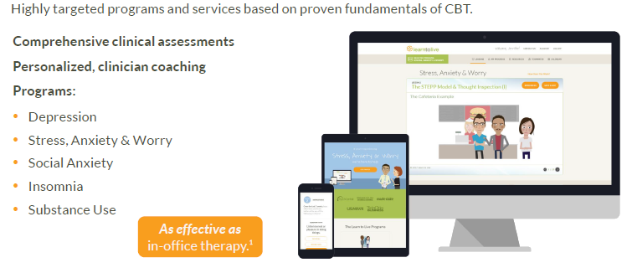
Learn To Live
Notes:
** Highly encouraged to attend the trainings

Slide 8
Career and Technical student organization
Goal: Produce students who are workforce ready
Middle and High school students are more likely to attend post secondary institutions with active chapters.
Opportunity for students who are in the trades to participate in competitions (list of competitions on the SkillsUSA website)

Slide 9
CLUB REQUIREMENTS
Involvement in Campus activities
One public service project each year (webinars, documentaries)
Attend Student Senate meetings or send a report to the Student Senate Secretary to be shared at meetings
Regular meetings during the year
Keep record of minutes
Submit required paperwork for travel at the beginning of each semester
Follow all College and Club policies and procedures
Notes:
Report has to be sent once a month
Link to the form in the email

Slide 10
PURCHASING PROCEDURES
Purchasing Procedures
A Purchase order must be generated before ordering
Provide notice two weeks ahead of time
More information on the website
Submit club purchase requisitions to Sheila
Use Purchase Requisition and RAISE forms on club/organization Resources website
Notes:
2. All Club/Organization Purchase Requisitions should be submitted to Sheila
Must have email address for vendor
Use Purchase Requisition and RAISE forms on Club/Organization Resources Webpage
Please review Student Life Board bylaws when requesting funding (will be approved by 9/19/18
3. Clubs must match 50% of travel costs provided by Student Life Board
New Travel Pre-approval Forms on Club/Organizations Resources Webpage

Slide 11
MINUTES AND AGENDAS
Why take minutes?
Clear record of what was decided at meetings
Clarification and understanding among members
Needed as documentation for travel
Minutes should include:
Date, time
Who attended
What was decided
Notes:
Sheila

Slide 12
STUDENT TRAVEL UPDATE
No out of state travel for the year of FY22
Virtual conferences/training opportunities are highly encouraged. (in person conferences must be approved by the COVID committee).
Complete paperwork at the beginning of each semester
Required student paperwork available on website
Paperwork must be complete with required signatures
Last minute requests will not be honored

Slide 13
FUNDRAISING/BUDGETS
Fundraising dollars can only be used to support Hennepin Technical College programs, students, and/or student activities.
Fundraising dollars cannot benefit any one particular individual or outside organizations.
All solicitation materials, text, and prospect lists must be approved by the HTC Foundation.
Fundraising funds must be received and deposited into the HTC Foundation.
Report total amount raised to the Director of Student Life and Chief Advancement and Communications Officer immediately following completion of the fundraising activity.
For questions regarding fundraising contact: Stephen Harper
Complete the Hennepin Technical College Foundation Student Fundraiser Approval Form
Notes:
Sue

Slide 14
Funding and financial requests
Club funding/fundraising
Event Planning
Purchasing/Student Travel Procedures
It is the advisors responsibility to know the policies and procedures in the Guidebook and help students through the different processes.
Reach out if you have questions!
Notes:
Laura

Slide 15
RECRUITING NEW MEMBERS
Announcements at Student Senate Meetings
Encourage current members to promote the club in their classes
Organize virtual ‘meet and greet’ via zoom
Collaborate with other clubs
Promote on D2L via senate page

Slide 16
Staying Connected
Store Club files
Communicate via chat
All Club members can join a “team”
Host meetings via video (club members)
Host club meetings (link can be shared with non members)

Slide 17
STAY CURRENT!
Is your Club social media up-to-date?
Notes:
Stephen

Slide 18
TIPS FROM CLUB ADVISORS
Open Purchase Orders
Be specific (US Bank, etc.)
Club leaders should be attending Student Senate meetings
Others?
Notes:
Create Open Purchase Orders at the beginning of the year for things you know you’ll be purchasing (Catering, US Bank, etc.)
If you have budget and need to purchase things right away create open PO
Encourage club leaders to attend Student Senate, will benefit when asking for funding.
Others?

Slide 19
MEETINGS TO KNOW ABOUT
Student Senate Meetings
EPC – 1st & 3rd Wednesdays of the Month (except for breaks) BPC – 2nd & 4th Wednesdays of the Month (except for breaks)
Via zoom! With on-campus option
Student Life Board Meetings
Dates available on Student Life Board Page
Notes:
Student Senate Meetings (12 – 1 pm)
EPC – 1st & 3rd Wednesdays of the Month (except for breaks)
BPC – 2nd & 4th Wednesdays of the Month (except for breaks)
Student Life Board Meetings (1:15 pm)
Video Conference on Both Campuses (F107)
Usually on the 3rd Wednesday of each Month, official dates listed
on Student Life Board Webpage

Slide 20
MARK YOUR CALENDARS!
Sept. 24 Student Club Leader Training at 1:00 pm via Zoom
Sept. 30 Annual Recognition & Club Advisor Expectations
March 25 Club leader lists due-SAL Awards (tentative)
April 1 Fiscal Year 2023 Club Funding Requests
May 1 Advisor End of year report Due
Notes:
Jese is Part time

Slide 21
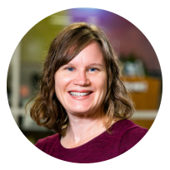
IMPORTANT CONTACTS
Laura Otieno
Student Life & Health Coordinator (BPC)
Jese Ledbetter
Student Life & Career Development Coordinator (EPC)
Stephen Harper
Director, Student Life & Career Development
Sheila Sylvander
Student Affairs Division Coordinator
Christine Kelling
Graduate Assistant, Student Life & Career Development
Vacant Position
Career Experience Coordinator
Visit website for zoom/in person hours!
Notes:
Sue

Slide 22
BPC Contact Stephen.Harper@hennepintech.edu EPC Contact Jese.Ledbetter@hennepintech.edu

